Slide 1
Movie Data Analytics

Slide 2




Team - 07 Chargers
Gnana Vardhan Siddu
Team Leader
Bhargavi
Team Member
Janani
Team Member
Giri
Team Member

Slide 3
The Problem
Problem #1
This is a sthe biggest issue facing recommender systems is that they need a lot of data to effectively make recommendations. It's no coincidence that the companies most identified with having excellent recommendations are those with a lot of consumer user data: Google, Amazon, Netflix, Last.fm.ample text.
Problem #2
When a new user joins the platform or when a new movie is released, there is insufficient data available to make accurate recommendations. Traditional recommendation algorithms rely on historical data, making it challenging to provide relevant suggestions for new users or movies.
Problem #3
Many recommendation systems focus solely on user ratings or interactions with movies, without considering other contextual factors such as genre preferences, viewing history, or external influences like current events or personal moods.

Slide 4
The Solution
Solution #1
recommender systems can employ techniques such as content-based filtering, which analyzes the attributes of items (e.g., movies) and recommends similar items based on their characteristics. This allows for making recommendations even when there is limited user interaction data available.
Solution #2
One approach to addressing the cold start problem is to use a hybrid recommendation system that combines different recommendation techniques. Content-based filtering can be utilized to recommend movies similar to the new movie based on its attributes (e.g., genre, director, cast), while collaborative.
Solution #3
Context-aware recommendation algorithms can leverage additional contextual features to improve recommendation relevance. For example, considering a user's viewing history and genre preferences can help tailor recommendations to their individual tastes, while incorporating external factors like time.

Slide 5
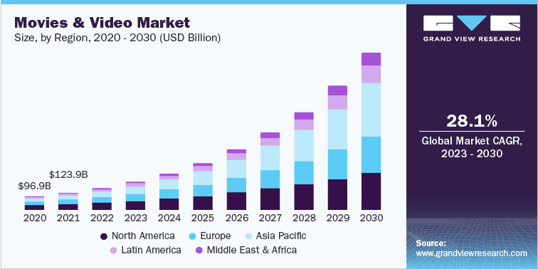
Market Size
10.3M

Slide 6
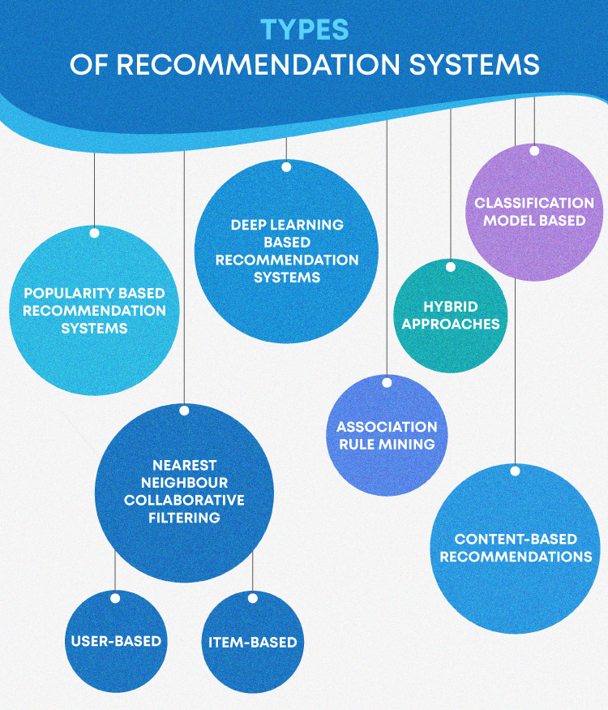
Business Model / Plan

Slide 7
Technology/expertise
Collaborative Filtering:
Collaborative filtering techniques analyze user behavior (ratings, preferences) to make predictions about what movies users might like.
Movie
Data Analytics
Content-Based Filtering:
Analyzing the attributes of movies themselves (genre, director, actors, etc.) to recommend movies with similar characteristics to those that a user has liked in the past.
Matrix Factorization:
Techniques like Singular Value Decomposition (SVD) or Alternating Least Squares (ALS) can be used to factorize the user-item interaction matrix to uncover latent factors representing user preferences and movie characteristics.

Slide 8
Competition
Competitors | Market Leader | Rising | Not doing great | Notes
Our Business |  |  |  | Leading in the top
Competitor A |  |  |  | Great competition
Competitor B |  |  |  | ---

Slide 9
Why We are Better?
Multi-Modal Recommendation:
Utilizing various data sources such as movie metadata, user ratings, reviews, and even contextual information like time of day or user location to provide diverse.
Advanced Algorithms:
Highlighting the use of advanced recommendation algorithms such as collaborative filtering, content-based filtering, and hybrid models.
Real-Time Recommendations:
Providing recommendations in real-time as users interact with the platform, ensuring up-to-date suggestions based on the latest trends and user behavior.

Slide 10
Measuring Success
Internal Dashboards
Measure the system's ability to accurately predict movies that users enjoy. Common metrics include precision, recall, F1-score, and Mean Absolute Error (MAE) or Root Mean Square Error (RMSE) for rating
User Engagement
Track metrics such as click-through rate (CTR), conversion rate (from recommendation click to movie watch), and time spent on the platform.
User Surveys
Monitor user retention rates and churn to gauge overall satisfaction and loyalty
.

Slide 11
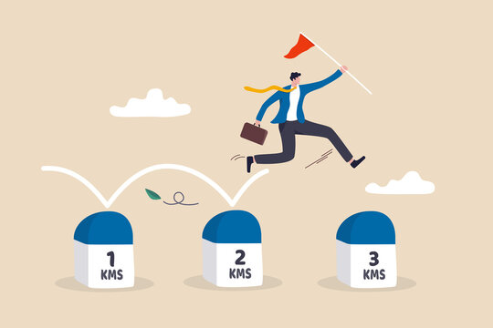
Roadmap, metrics milestones
Milestone #1
Evaluate algorithm performance using metrics such as precision, recall, and MAE.
Milestone #2
Integrate recommendation functionality into the platform, ensuring seamless operation.
Milestone #3
Gather qualitative and quantitative feedback on user experience and satisfaction.

Slide 12
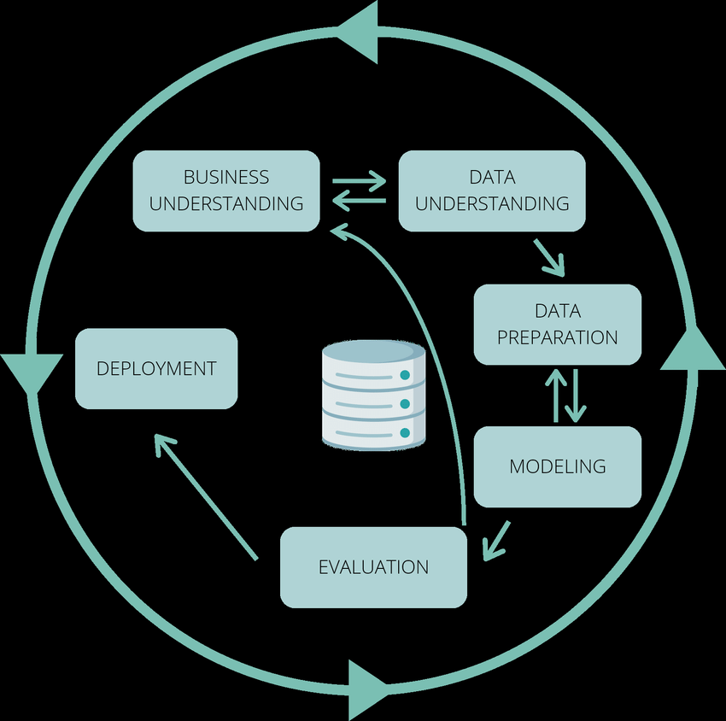
CRISP DM Methodology.

Slide 13

Business Understanding
Identify the primary stakeholders, such as the platform owners, content providers, advertisers, and end-users.
Understand their objectives and expectations regarding the recommendation system. For example, increasing user engagement, driving subscription or ad revenue, or enhancing the overall user experience.
Understand the distinct needs and preferences of different user segments to tailor recommendations effectively.

Slide 14

Data Understanding
Develop processes to collect and ingest data from various sources, such as streaming platforms, databases, APIs, and user input forms.
Implement mechanisms for real-time data streaming and batch processing to handle both streaming and historical data.

Slide 15

Data Preparation
Integrate data from multiple sources to create a unified dataset.
Resolve inconsistencies and conflicts between different data sets, such as discrepancies in movie titles or genres.
Extract relevant features from the data that can be used to model user preferences and movie characteristics.

Slide 16
Modelling
Select and implement appropriate recommendation algorithms, such as collaborative filtering, content-based filtering, or hybrid approaches.
Train the models using the prepared data, tuning hyperparameters and optimizing performance as needed.
Evaluate the models using validation techniques such as cross-validation and holdout validation to assess their accuracy and generalization ability.

Slide 17

Evaluation
Assess the performance of the recommendation system using evaluation metrics such as precision, recall, F1-score, and Mean Absolute Error (MAE) or Root Mean Square Error (RMSE) for rating prediction models.
Validate the effectiveness of the recommendation system through A/B testing or user studies, comparing user engagement and satisfaction with and without the recommendation system.

Slide 18

Deployment
Deploy the recommendation system into production, integrating it with the platform's user interface and backend infrastructure.
Monitor the system's performance in real-time, ensuring scalability, reliability, and responsiveness to user interactions.
Implement mechanisms for collecting user feedback and monitoring key performance indicators (KPIs) to continuously improve the recommendation system over time.

Slide 19


